Slide 1

STRESS RELATED DISORDERS: THE CASE OF MR. PENZEY
Case Study
Patient Name: Mr. John Penzey
Age: 30
Symptoms: Nausea, headaches, muscle cramps, increased urination and blurred vision
Medical History: Tonsillectomy age 5
Family History: Mother deceased from myocardial infarction, father still living with diabetes and high blood pressure
Review Mr. Penzey's medical information and tests to determine what his condition might be.

Slide 2
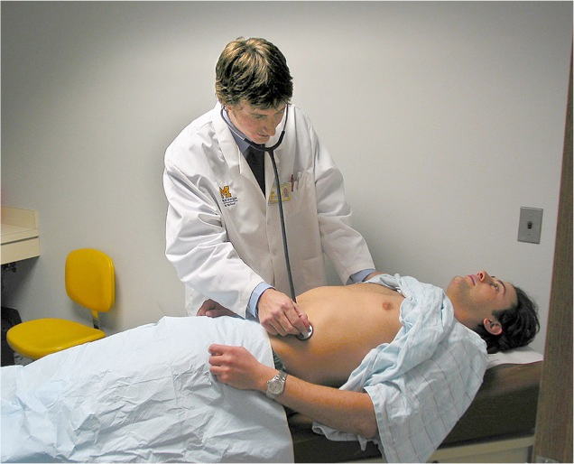


Blood Pressure and Heart Sounds
Blood pressure: 170/90
Not only is Mr. Penzey's blood pressure results elevated, you notice upon listening with the stethoscope an abnormal, low frequency gallop sound.
Heart Sounds
A normal heart beat sounds like this:
Normal Heart Sound
Mr. Penzey's heart sounds are more abnormal like this:
Mr. Penzey's heart sounds

Slide 3
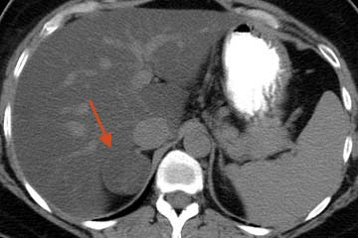
CT and Lab Results
A CT scan was performed (shown on the left) which demonstrated a mass on the right adrenal gland (right arrow).
Compare Mr. Penzey's results (patient) below to the normal or reference range for each of the components tested from his blood sample.
Lab Results:
Reference Patient
Sodium 136-144 mmol/L 150
Potassium 3.7-5.2 mmol/L 3.0
Renin 0.5-3.3 ng/mL/hr 0.4
Aldosterone 2-9 ng/dl 21
serum pH 7.35-7.45 7.45

Slide 4
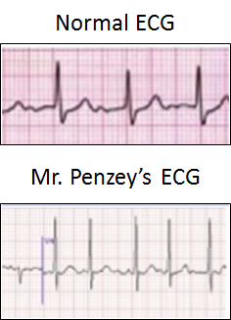


ECG Results
ECGs are often used to look at abnormalities in heart conduction. They are also a good tool for understanding how the heart functions together with the nervous system. An electrocardiogram (ECG) represents the electrical current moving through the heart during a heartbeat. ECGs can assist doctors in diagnosing and determining any current or past heart abnormalities and can be a regular screening tool for those with heart disease.
Note the normal ECG on the top left compared with Mr. Penzey's ECG on the bottom. Notice the pronounced QRS complex as compared to the normal reading followed by a quick downward slope of the T wave just after the QRS complex.

Slide 5
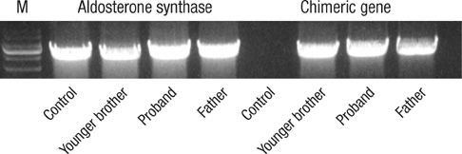
Genetic Testing
A polymerase chain reaction test or PCR was performed on the DNA extracted from the patient. His father and younger brother also volunteered samples of their blood for comparison. All three family members showed the presence of the chimeric 11beta-hydroxylase/aldosterone synthase gene on an agarose gel.
When ACTH binds to this abnormal gene it triggers the production of aldosterone synthase. Aldosterone synthase becomes over-expressed in all the family members versus the control sample (M) as seen on the agarose gel.
This concludes the case study on Mr. Penzey. Answer the questions within the case assignment to complete the lesson.

